Slide 1



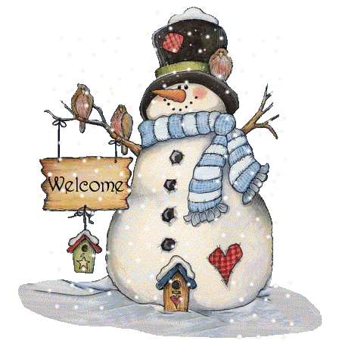
warm up

Slide 2
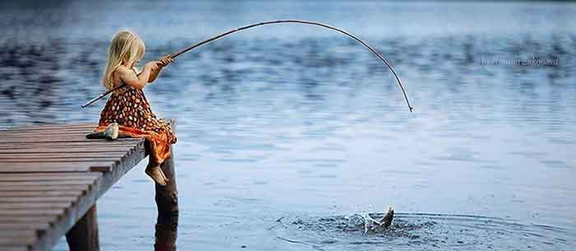
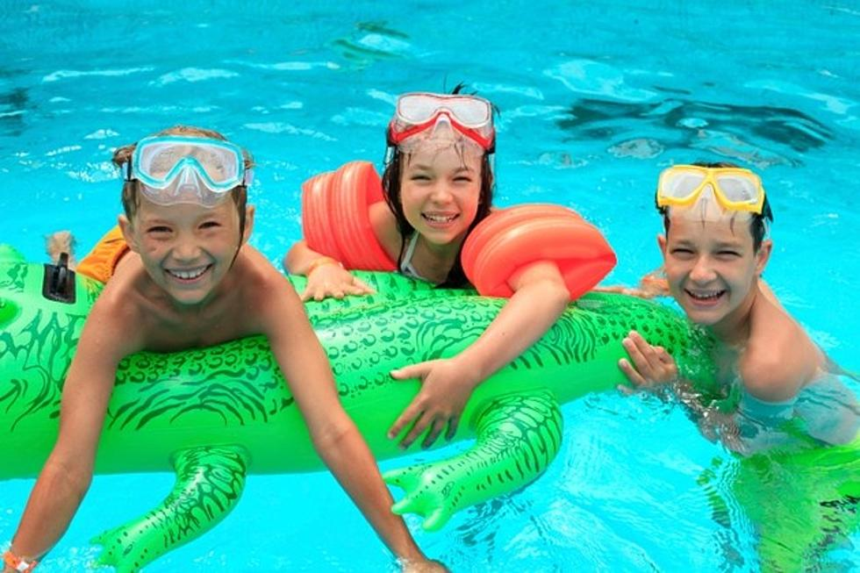
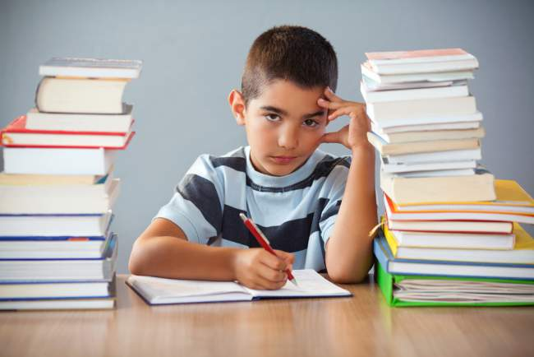
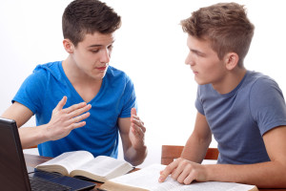
go fishing
go swimming
do my homework
study with a partner

Slide 3

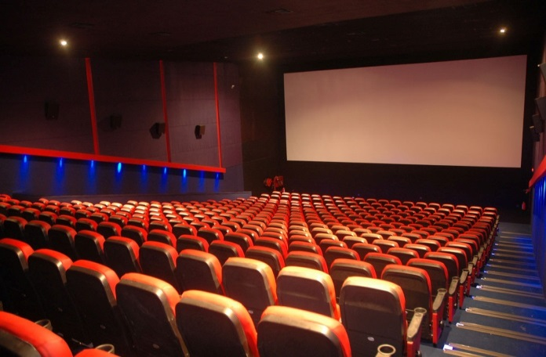
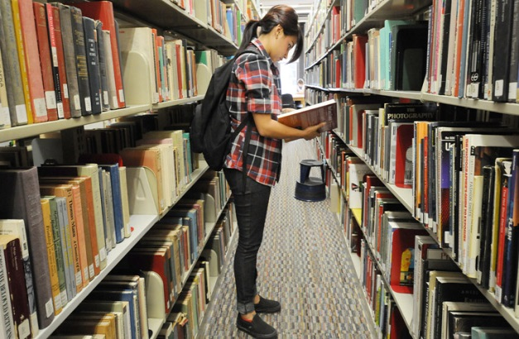
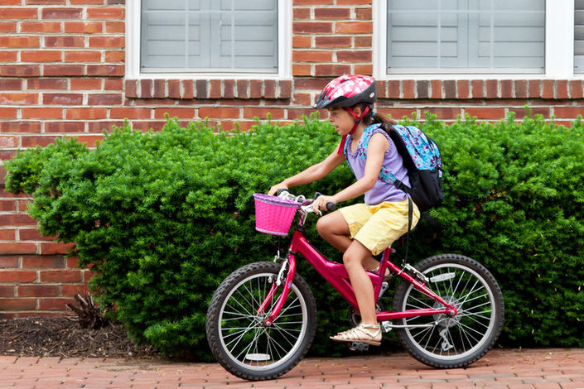
surf the Internet
go to the cinema
go to the library
= come to the library
ride a bicycle
to school

Slide 4
Unit 2. Write about your day
1. What’s your name?
2. What do you do in the morning?
3. What do you do in the afternoon?
4. Do you like watching TV?
5. How often do you watch TV?
Nguyen
5C
Hello, my name is........................I’m in class ..............
I’m .....................years old. I..........................................
........................................in the morning.
I .....................................................................in the afternoon.
I ..............................................................................
I watch TV............................................................................
eleven
have breakfast,
go to school
do my homework, go swimming
like watching TV
three times a week/four times a week

Slide 5
unit 2. lesson 3
I. vocabulary:
≠
go jogging: chạy bộ
go shopping: đi mua sắm
go to bed = go to sleep: đi ngủ.
before: trước khi ≠ after: sau khi
before breakfast: trước bữa ăn sáng
after school: sau giờ học
English for Kids: Tiếng Anh cho trẻ em
programme = program: chương trình

Slide 6
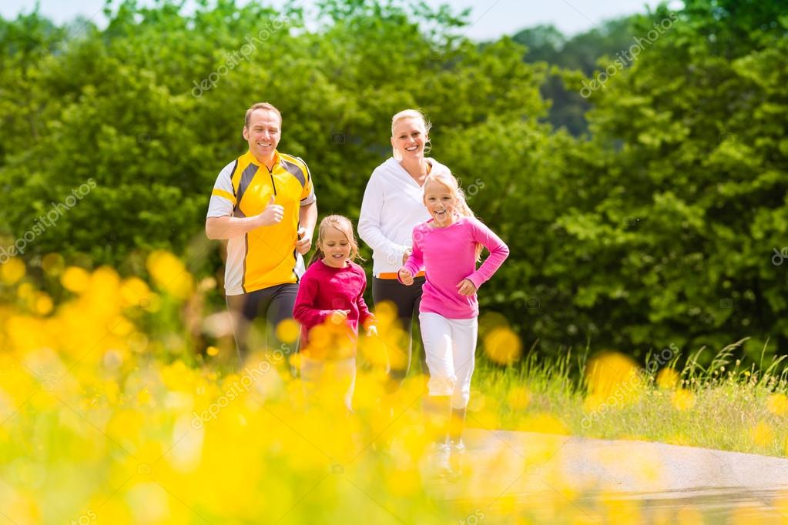
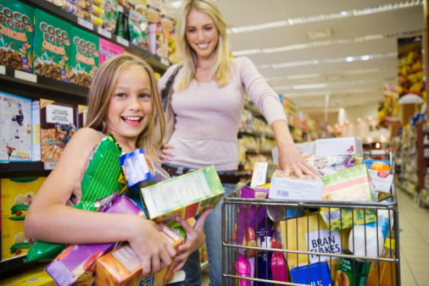
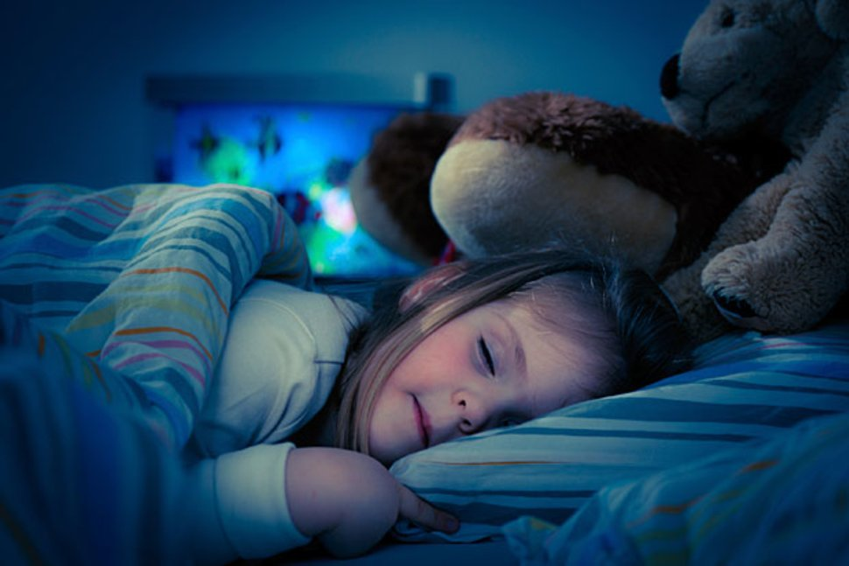
go jogging
go shopping
go to bed = go to sleep

Slide 7
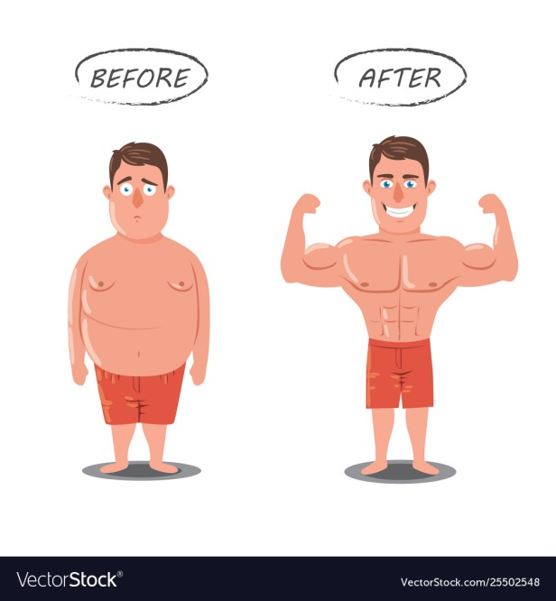
before:
after :
trước khi
sau khi
before breakfast:
trước bữa ăn sáng
after school:
sau giờ học

Slide 8
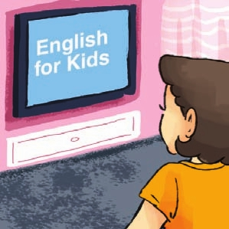
English for kids:
Tiếng Anh cho
thiếu nhi
Programme:
chương trình

Slide 9
Exercise 4/17
Hoa's Day In the morning, Hoa gets up early. She usually goes jogging. After breakfast, she rides her bicycle to school. After school, she usually does her homework. Then she often plays badminton and sometimes cooks dinner. In the evening, she sometimes watches TV. She watches English for Kids once a week. She usually goes to bed early. She goes shopping twice a
week . Ơ
1.What does Hoa do in the morning?
.........................................................................................................
2.What does she do after school?
.........................................................................................................
3.What TV programme does she watch once a week?
..............................................................................................................
4.How often does she go shopping?
...............................................................................................................
1
2
3
4
5
6
7
1. What does she do in the evening?
.........................................................................
2. What does she do after breakfast?
.........................................................................
In the morning, Hoa gets up early. She usually goes jogging.
In the evening, she sometimes watches TV.
After school, she usually does her homework.
She watches English for Kids once a week.
After breakfast, she rides her bicycle to school.
She goes shopping twice a week.

Slide 10
Exercise 5/
My name is________________ .
In the morning, I always ________________
_______________________________.
In the afternoon, I usually _______________
_______________________________.
In the evening, I _______________________.
I ___________________________ a week.
Nguyen
go to school
do my homework/
cook dinner
watch TV/ listen to music
listen to music four times

